Slide 1

TestNG Introduction
Nhóm 1

Slide 2

Contents
04 - Steps to write
Test Case with TestNG
Test automation - 01 framework
05 - Demo
What is TestNG? - 02
TestNG vs. JUnit - 03

Slide 3

GROUP MEMBERS:
Huỳnh Thế Hiển
Cao Quỳnh Trang
thehienvnag@gmail.com
trangcaoquynh1207@gmail.com
Đồng Hữu Long
Đỗ Đức Nam
thaiduc@gmail.com
namdoduc.hcm@gmail.com
Hứa Nhật Quang
Ngô Vũ Khả Minh
quanghnse140846@fpt.edu.vn
anhkhaLover@gmail.com

Slide 4

Test Automation Framework

Slide 5
- A test automation framework is an integrated system that sets the rules of automation of a specific product.
- Types of test automation frameworks exists for many languages, like Java, C#, PHP, etc...

Slide 6





Slide 7
02. What is TestNG?

Slide 8
- TestNG is a testing framework inspired from JUnit and NUnit.
- It is an open-source automated testing framework; where NG of TestNG means Next Generation.
- TestNG gives capabilities to write more flexible and powerful tests.

Slide 9
03. TestNG vs JUnit?

Slide 10
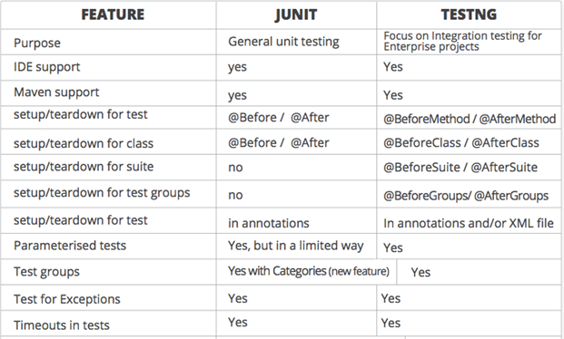

Slide 11
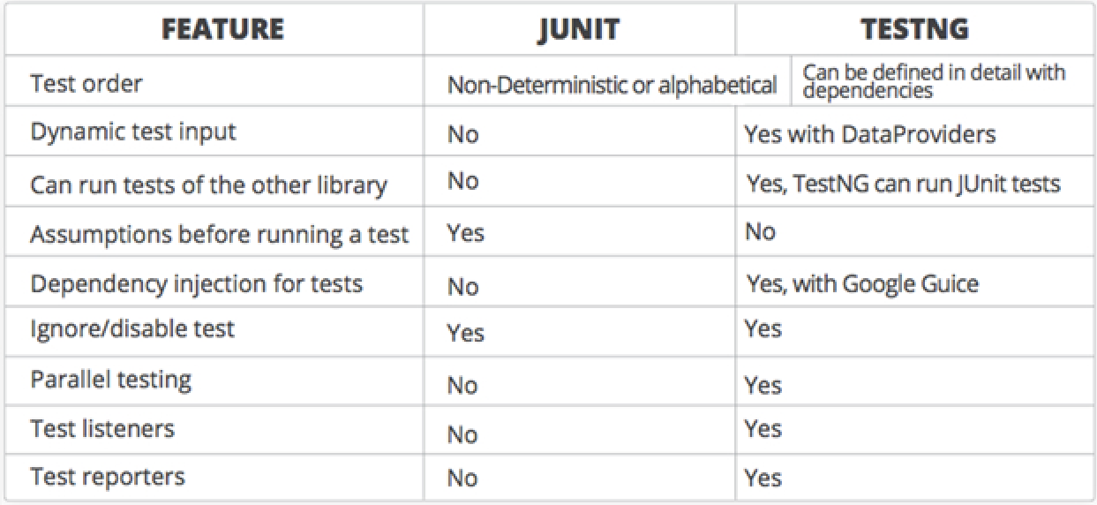

Slide 12
04. Steps to write Test Case with JUnit

Slide 13
Step 1 – Write the business logic of the test.
Step 2 – Insert TestNG annotations in the code.
Step 3 – Add the information about your test (e.g. the class names, methods names, groups names, etc…) in a testng.xml file.
Step 4 – Run TestNG.

Slide 14
@BeforeTest
@AfterTest
@BeforeClass
@AfterClass
@BeforeMethod
@AfterMethod
@Test

Slide 15
05. Demo

Slide 16

REFERENCES
What is TestNG? - Link
TestNG Framework - Link

Slide 17

THANK YOU FOR YOUR ATTENTION!

